Slide 1
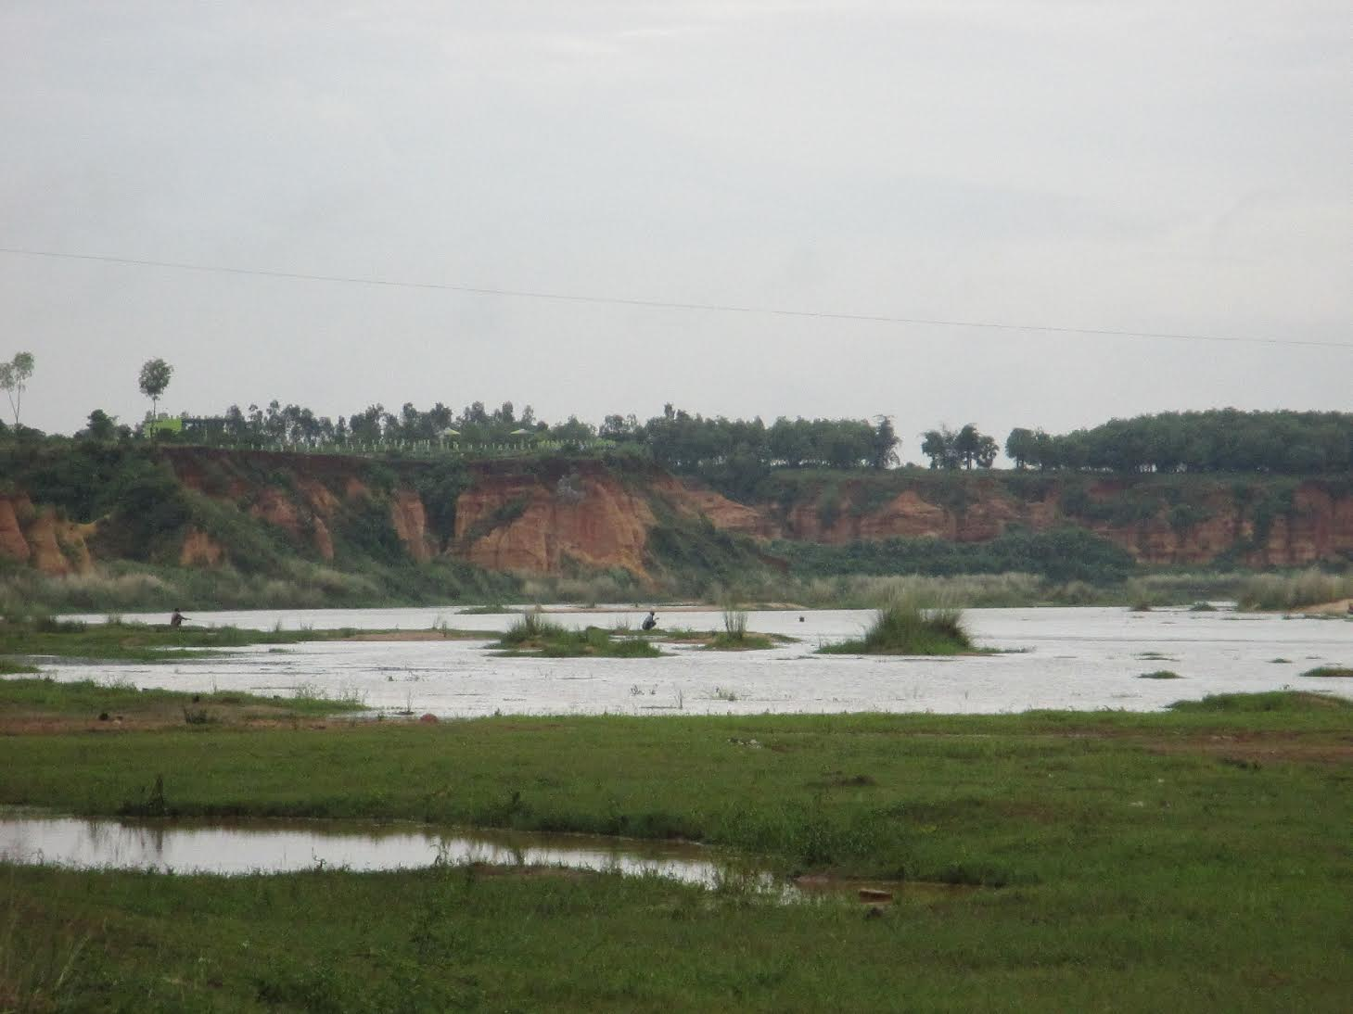
Where is the farmer in Indian agricultural policy?
Development Research Day, 2016
Srilata Sircar

Slide 2
A Historical Overview
1950s to mid-1960s
Infrastructural and Institutional Focus
Land reforms- ceiling on holdings, formalization of tenancy contracts, redistribution
Irrigation extension (dams, canals)
Extending the area under cultivation

Slide 3
A Historical Overview
1950s to mid-1960s
Late 1960s to 1980s
Infrastructural and Institutional Focus
Land reforms- ceiling on holdings, formalization of tenancy contracts, redistribution
Irrigation extension
Technocratic Focus
Agricultural research and extension
Price interventions- Food Corporation of India & Agricultural Prices Commission
Green Revolution

Slide 4
A Historical Overview
1950s to mid-1960s
Late 1960s to 1980s
1990s
Infrastructural and Institutional Focus
Land reforms- ceiling on holdings, formalization of tenancy contracts, redistribution
Irrigation extension
Technocratic Focus
Agricultural research and extension
Price interventions- Food Corporation of India & Agricultural Prices Commission
Green Revolution
Policy Vacuum/Indifference
Impact of policies from other sectors
Limited coverage of price support
Increasing reliance on investments from farmers

Slide 5
New Agricultural Policy (2000)
Introduced in response to rising farmer indebtedness, agrarian distress including farmer suicides, and widening regional disparities
Focus on the key areas of :
Growth (targeted 4%, actually achieved 2.3% on average through wide fluctuations)
risk management (through crop insurance, meant to be provided through financial inclusion)
export orientation of agricultural production (diversification and cash crops)
and provision of rural credit (through financial inclusion)
No concrete plan for implementation!

Slide 6
Swaminathan Committee on Farmers (2006)
Constituted in 2004 after formation of a new government and pressure from agricultural interest groups
Key recommendations:
Prevent diversion of agricultural land and forests to the corporate sector for non-agricultural pruposes
Complete the un-finished (un-begun?) land reforms
Re-instate customary rights to common property resources for Adivasis and pastoralist communities
Re-instate the universal public distribution system to ensure food security
Two points of departure: the farmer is not merely a food producer but also a food consumer and therefore vulnerable to food insecurity; the farmer is not a monolithic figure

Slide 7
Who is the “farmer” in Indian agriculture?

Slide 8
Who is the “farmer” in Indian agriculture?
Underlying assumptions:

Slide 9
Who is the “farmer” in Indian agriculture?
Underlying assumptions:
The identity of the farmer is/can be derived from the size of landholdings

Slide 10
Who is the “farmer” in Indian agriculture?
Underlying assumptions:
The identity of the farmer is/can be derived from the size of landholdings
Productivity translates into income

Slide 11
Who is the “farmer” in Indian agriculture?
National Policy for Farmers (2007), Ministry of Agriculture, Govt. of India, p.2

Slide 12
Who is the “farmer” in Indian agriculture?
Cultivation through wage labor
Big(ger) landowning, pluriactive households, new forms of absenteeism
Wage labor from Dalit, Adivasi, or other marginalized groups

Slide 13
Who is the “farmer” in Indian agriculture?
Cultivation through wage labor
Share-cropping
Big(ger) landowning, pluriactive households, new forms of absenteeism
Wage labor from Dalit, Adivasi, or other marginalized groups
Informal contracts, wide varieties in contractual practices
Insecurity of tenure

Slide 14
Who is the “farmer” in Indian agriculture?
Cultivation through wage labor
Share-cropping
Tenancy
Big(ger) landowning, pluriactive households, new forms of absenteeism
Wage labor from Dalit, Adivasi, or other marginalized groups
Informal contracts, wide varieties in contractual practices
Insecurity of tenure
Land rented out for cash rents
Usually entered into by middle-ranking, agrarian capitalist castes
Not a favored option for landowning households

Slide 15
Who is the “farmer” in Indian agriculture?
Cultivation through wage labor
Share-cropping
Tenancy
Combination farming
Big(ger) landowning, pluriactive households, new forms of absenteeism
Wage labor from Dalit, Adivasi, or other marginalized groups
Informal contracts, wide varieties in contractual practices
Insecurity of tenure
Land rented out for cash rents
Usually entered into by middle-ranking, agrarian capitalist castes
Not a favored option for landowning households
A combination of share-cropping, family labor on family farms, wage labor etc.

Slide 16
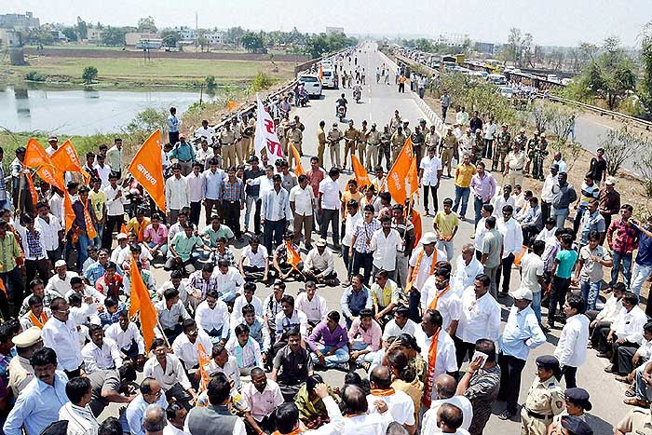
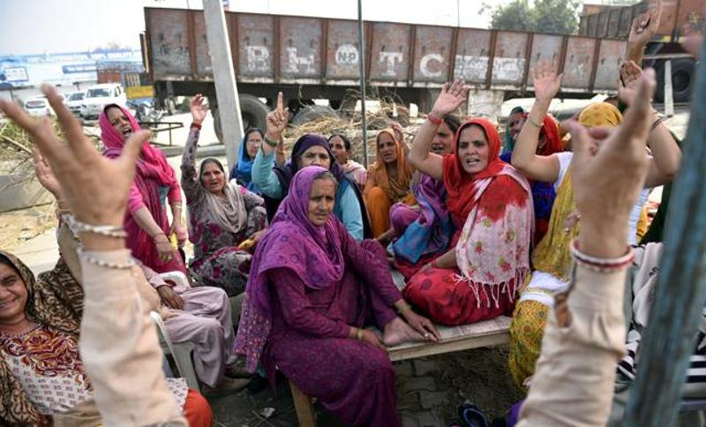
Where is the farmer in Indian agriculture today?

Slide 17
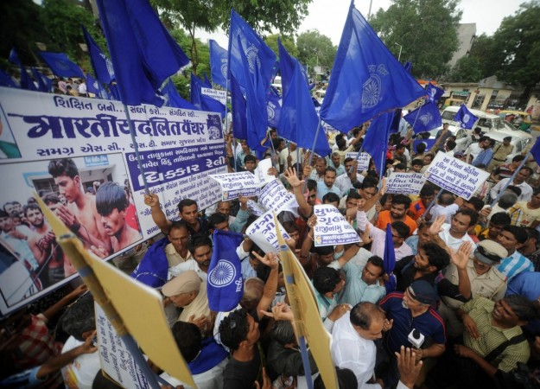
Where is the farmer in Indian agriculture today?
Mr. Mevani said that Dalits in Gujarat had not restricted their struggle on the issue of cow alone.
“It is now converted into a movement seeking land rights. Similar struggle should be launched in Karnataka too and the government should be asked to bring out white paper on lands allotted to industries and others,”
http://www.thehindu.com/news/national/una-dalit-leader-jignesh-mewani-interview-material-issues-are-at-the-heart-of-dalit-politics/article9136880.ece

Slide 18
Where is the farmer in Indian agriculture today?
According to National Sample Survey 70th round, average agricultural income per household is below 60 USD per month and income including non-agricultural sources is below 100 USD per month
Of 220 million new bank accounts opened since 2014, half were found to be at zero balance and further 20 million had a balance between INR 1 and INR 10 i.e. 0.02 to 0.20 USD
Average income of Dalit households in rural areas is 38% less than that of other groups and 93% Dalit families lived below the poverty line in 2012

Slide 19
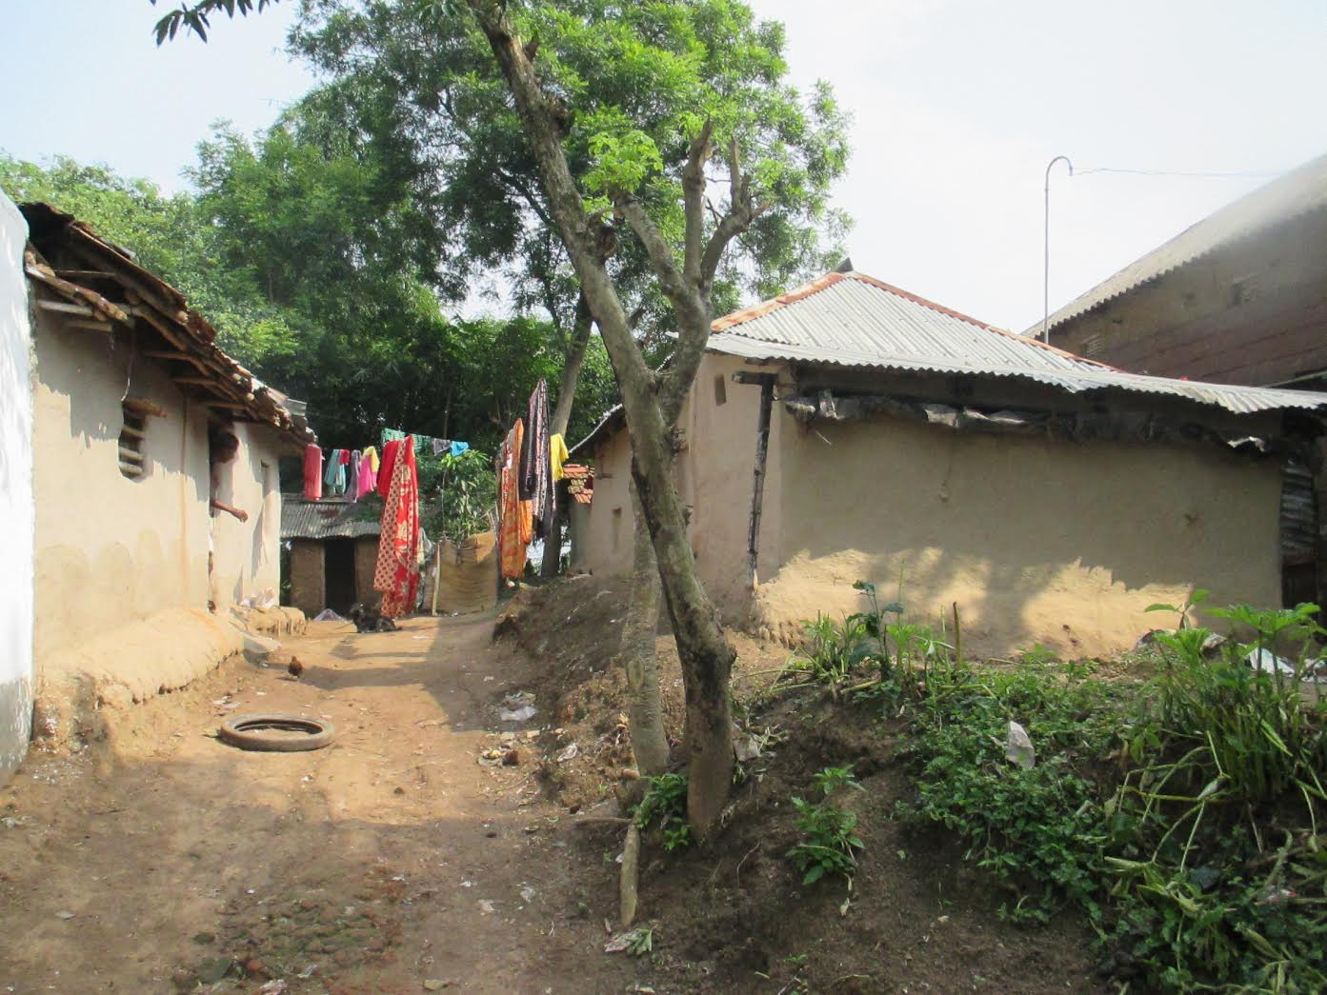
What did we miss?
Is it possible to attend to questions of agriculture and farming without attending to questions of caste?

Slide 20
What did we miss?
Is it possible to attend to questions of agriculture and farming without attending to questions of caste?
Is it possible to attend to questions of agriculture and farming without attending to questions of redistributive justice?

Slide 21
What did we miss?
Is it possible to attend to questions of agriculture and farming without attending to questions of caste?
Is it possible to attend to questions of agriculture and farming without attending to questions of redistributive justice?
Is it possible to attend to questions of agriculture and farming without attending to questions of lower-level urbanization and the informal sector?

