Slide 1
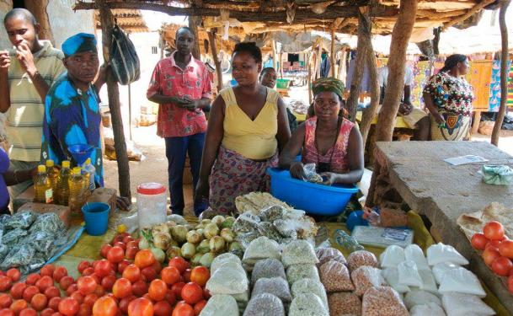
Development Research Day 2016
Development Research Day 2016

Slide 2
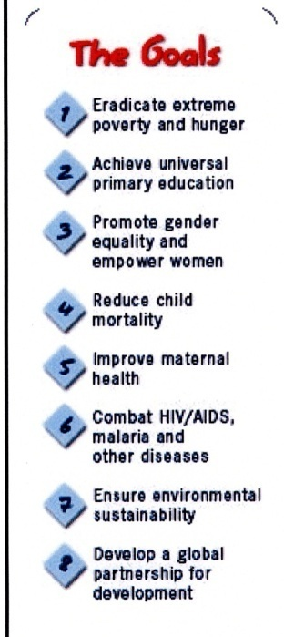
FOOD SECURITY, again on the top of the list…
The 8 MDGs The 17 SDGs
…..globally.

Slide 3
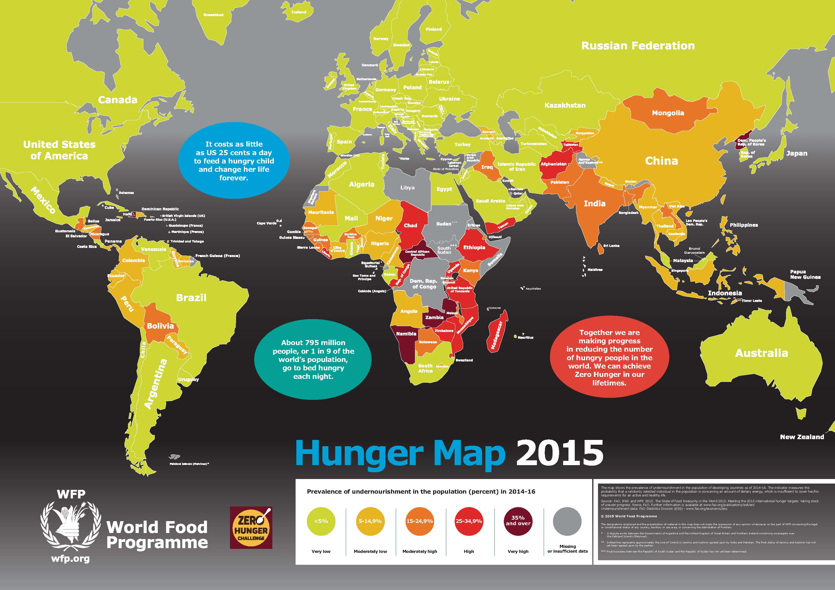
The situation, TODAY!

Slide 4
Need for improved nutrition, Today!

Slide 5
Development Research Day 2016
Morning Schedule
09.30-10.00: Reducing Poverty Through Agriculture – challenges and possibilities,
Camilla Lundberg Ney, We Effect
10.00-10.30: Where is the Farmer in Indian Agricultural Policy?
Srilata Sircar, Lund University
10.30-11.00: What is Africa doing about Sustainable Development Goal 2?
Joseph Karugia, Regional Strategic Analysis and Knowledge Support System for
Eastern and Central Africa
11.00-11.30: Coffee break
11:30-11.40: Announcement of the The Hydén Award for Best Thesis on Democratisation and Development in the Third World
11.40-12.30: Panel and discussion, moderated by Magnus Jirström

